Slide 1



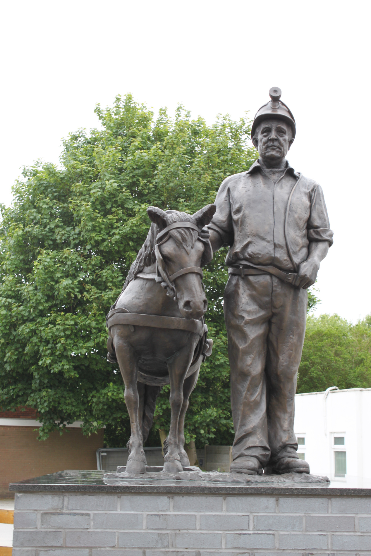

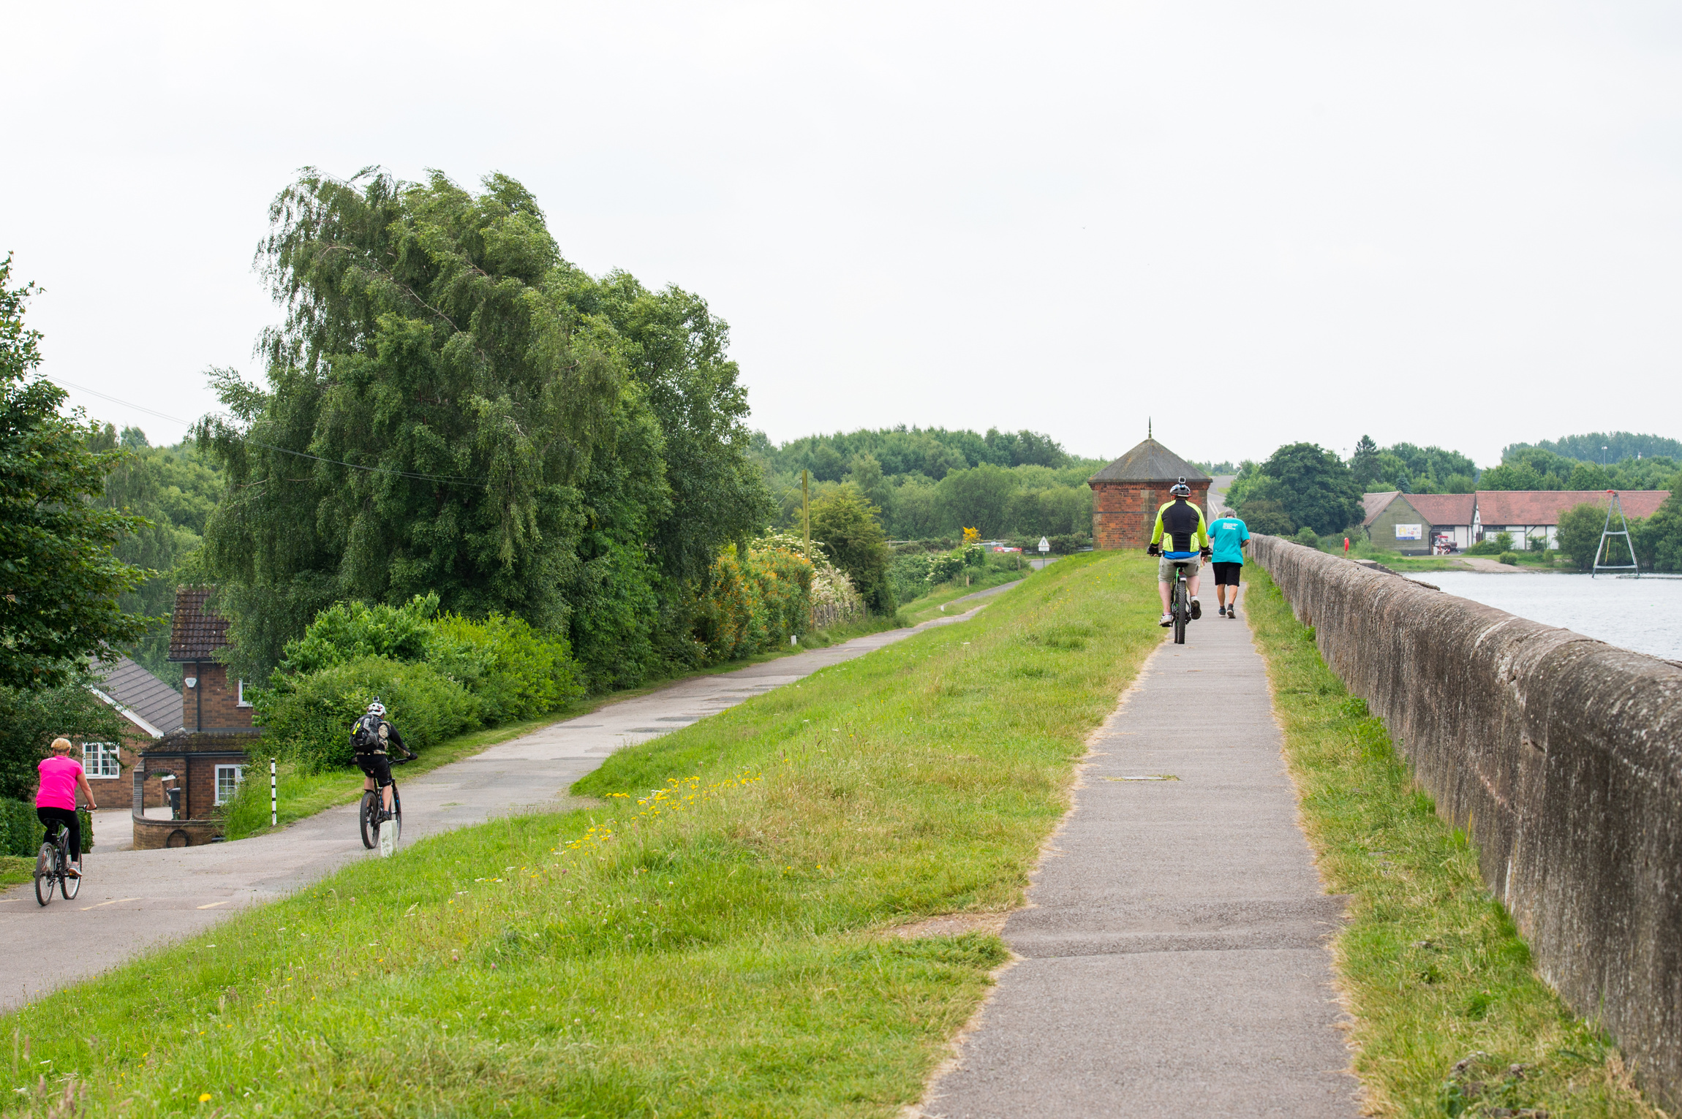
Selling to Lichfield District Council
A Guide for Suppliers and Contractors
Last updated: August 2025

Slide 2

Contents
About this guide
How is procurement organised?
Rules and regulations
EU Procurement Directives
How do I find out about opportunities?
Our procurement process
Social Value
Council expectations of contractors
FAQs

Slide 3
About this guide
This guide has been put together to help local businesses wanting to sell their services and supplies to Lichfield District Council.
It outlines:
Where businesses can find details of opportunities to supply the council.
The rules that Lichfield District Council must follow.
How to tender for the council’s business.
What is expected of you when undertaking work for us.

Slide 4
How is procurement organised?
Lichfield District Council has a small procurement team, which is responsible for developing the council’s procurement strategy, policy, good practice and procedures to secure best value-for-money. It is also responsible for advising council officers who have responsibility under devolved procurement arrangements, of running procurements to secure the goods, services and works they need within their service areas.
There are many different forms in which contracts let by the council can take, below is a brief outline of some of those forms:
Purchase Orders: Essentially one-off contracts. These contracts meet specific needs/individual requirements and tend to below procurement activity thresholds.
Framework Agreements: A tender process with the aim to establish an agreement where terms and conditions are put in place with the successful provider(s) for services, supplies or works. When a requirement is identified it can be sourced via the framework through a call-off mechanism.
Open Framework Agreements: Unlike traditional closed frameworks, however, contracting authorities will be permitted to appoint new suppliers to the framework during its lifetime. To facilitate this, open frameworks may be opened up at least twice whilst they are already live.

Slide 5
Dynamic Markets: A dynamic market is an electronic list of qualified suppliers that a contracting authority uses for a wide range of goods, services, and works. Suppliers must meet pre-defined conditions to join, and the dynamic market remains open for new members to join or existing members to apply for contracts at any time.
Tendering for a contract: These are tenders accepted from a contractor, to carry out repetitive tasks for a defined period of time. Work is then issued to the successful contractor(s) as and when it is available. These are usually for planned and reactive works.
Consortiums: Different procurement authorities can join together to form a consortium to create tenders as a group. This can provide better value for money as larger quantities can be purchased. This also apply to bidding providers, who can join together to form a consortium to provide a better value for money tender bid and cover a wider area of works and services.
As a public body, Lichfield District Council also has access to contracts arranged by organisations such as Crown Commercial Services (CCS), Eastern Shires Purchasing Organisation (ESPO), Yorkshire Purchasing Organisation (YPO), SCAPE and others.

Slide 6
Rules and regulations
As a public body, there are regulations which the council has to follow when procuring supplies, works and services. It is important for businesses wishing to work with us to be
fully aware of the rules and regulations, which govern the way we operate.
This table summarises the rules and basic level thresholds that must be followed. The value of the requirement, whether estimated or exact, will determine the way in which it is purchased:
As a smaller council it will be very rare that we undertake major works procurements, or indeed many EU procurements.
We will generally seek to use pre-existing framework agreements that are available to us as they have been through robust procurement processes and typically offer value for money.
Value of supply for the life of the contract | Process
Up to £1,000 | Best value
£1,000 - £9,999 | Two quotations will be invited
£10,000 - £149,000 | Three quotations will be invited, or a tender process ran
£150,000 – EU threshold | Tenderers will be invited
For supply above EU threshold | EU Directive tender process
For works above EU threshold | EU Directive tender process

Slide 7
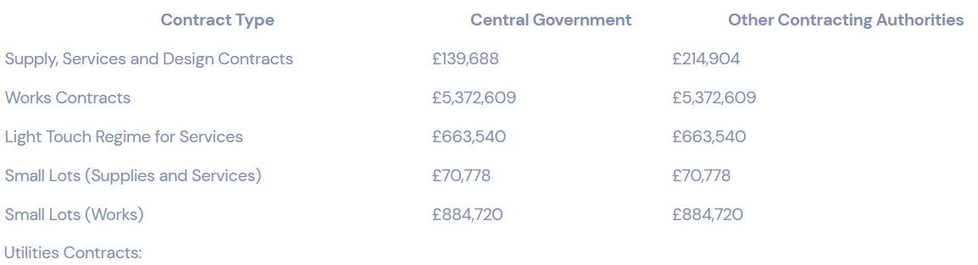
EU Procurement Directives
The council has a legal requirement to comply with the EU Procurement Directives, which govern the way public sector procurement is conducted for contracts over certain specified thresholds. The directives and regulations require the council to follow detailed procedures for all procurements above these financial thresholds. The overriding principle of EU
regulations (and of the council’s internal rules) is equality of treatment and transparency of process.
The thresholds (inclusive of VAT) for 2024/25 are:

Slide 8
If the value of the goods/service/works is above the threshold for quotation, under the EU Procurement Directives, Lichfield District Council can conduct its procurement using one of the below processes:
Open | Competitive Flexible
A single-stage process where any interested supplier can submit a tender, suitable for clear and well-defined requirements. | A multi-stage, flexible method allowing contracting authorities to design a tailored process, including elements like negotiation, dialogue, or demonstrations to best fit complex or tailored procurements.
Direct Award | Call-off from 3rd party Framework / Dynamic Market
A non-competitive route where a contract is awarded without a formal competitive tendering process, used in limited circumstances. | Offers the potential for mini-competitions or direct award, where suppliers have already been assessed competitively.

Slide 9
How do I find out about opportunities?
We aim to advertise opportunities to supply goods and services to us on our tendering portal. Find out more at www.lichfielddc.gov.uk/opportunities
Our tender opportunities of more than £25,000 are also listed on government's contracts finder at www.gov.uk/contractsfinder
If the tender amount is over the EU thresholds, they are also listed at https://www.find-tender.service.gov.uk/Search
You can register for all these systems for free and they will notify you of relevant opportunities.
We will also be using social media as a way to advertise some of our opportunities, so please keep an eye on our Facebook posts by following @lichfielddc and Twitter feed by following @Lichfield_DC.
In addition, we are also preparing a forward work plan that will list upcoming procurements, which will be available at www.lichfielddc.gov.uk/opportunities

Slide 10
Our procurement process
Notify suppliers
Unless a pre-existing framework is used, which will set out how we engage with those suppliers, and depending upon the value of the contract, we will notify suppliers either:
Directly through our e-Tendering system by invitation, or email
By placing notifications on the relevant online portals
Selection of suitable and qualified supplier
The council has a duty to ensure contractors/suppliers are suitable and qualified to deliver the goods/services/works. This can be done through pre- qualification questions before the tender, or a selection of questions as part of the tender process or through self-certification.
Submission of quotation or tender response and evaluation
The value of the contract will determine if the process followed is one for a quote or tender.
Quotations are a quick and straightforward process and will usually require submission to our e-Tendering system. Documentation will usually include some or all of the following :
Instructions to quote
Specification of requirement
Method statements
Evaluation criteria

Slide 11
Tenders are more in depth processes and take more time to complete and are for higher value contracts. As mentioned there are different ways for identifying tender opportunities. The tenders documents will be available through our e-Tendering system and will include document such as:
Instruction to tender
Specification requirements
Method statement
Evaluation criteria and scoring methodology
Pricing schedule
Contract terms and conditions
Evaluation
Tenders will be evaluated by the Most Advantageous (MAT) or price only.
MATs will give weighting against the price submission and the quality submission scores of the tender, e.g. 60% price, 40% quality.

Slide 12
Evaluation of the most advantageous tender can incorporate a number of factors including but not limited to:
Financial viability of the tender
Quality issues
Technical merit
After sales service
Delivery date
Technical back-up
Experience
Competence
Policy issues such as equality and sustainability
Social value
Contract awarded
Tender evaluations are always carried out in a comprehensive, equitable, auditable and transparent manner, ensuring fairness to all suppliers while following the evaluation criteria and method as set out in the tender.
Contracts will be awarded to the tender whose overall score is the highest under the terms and conditions set out in the tender documentation.

Slide 13

Social Value
As covered under the Public Services (Social Value) Act 2012, we wish to engage with providers who can promote and contribute to the economic, social, and environmental well-being of the district as part of the contract.
Social value is how we give back to the local community - for every pound we spend on delivering goods, services, or works, that pound will also produce wider benefits for our district. It is a key part of our tender process, especially with our larger contracts - when we contract for goods, services, and works, we consider how that contract can support and benefit to our communities. We review the social value offer based on what will be provided beyond the main contract.
Organisations who promise to provide a high level of social value are more likely to be awarded contracts than those who do not, and we look for providers who can demonstrate that:
they clearly understand what social value means
social value is rooted within their organisation
they can identify, plan, and effectively deliver social value
they are committed to measuring the impact delivered
We encourage contractors to take inspiration from our community wishing well and/or suggest their own ideas. You can find out more information about social value via our website.

Slide 14
Council expectations of contractors
Lichfield District Council’s Contract Procedure Rules can be downloaded via our website.
The council needs to ensure that it offers value-for-money procurement. We therefore expect a certain level of performance from contractors/suppliers, demonstrated but not limited to the following:
Value for money
This can be demonstrated through best price, best administration costs, best costs related to quality or any added value. Suppliers should consider the total, whole life costs of supply when putting together their tenders.
Quality
Contractors/suppliers are expected to provide services, supplies and works to an appropriate standard of quality, to meet the needs set out in the specification.
Adherence to the council's policies and protocols
We are committed to delivering our services, with consideration for a number of issues, including sustainability, equalities, health and safety, and look for suppliers/contractors who are committed to helping us achieve our aims in these respects.

Slide 15
Timescales
Tenders must be returned by the date given as any tenders received after the deadline may not be considered.
Innovation
Suppliers are encouraged to be innovative and suggest new ideas to add value, continuously striving to improve their performance.
Communication
Suppliers are expected to maintain good communications with the council throughout the contract and will be expected to attend regular contract review meetings.
Integrity
Honesty is expected in all dealings between the council and its contractors. In particular itis a criminal offence to give or offer any gift, inducement or reward to an employee of a public body. It is the council's policy not to accept inducements, gifts or hospitality. Tenderers should note that they risk being excluded from the procurement process for failing to observe this requirement.

Slide 16
The Living Wage
The Living Wage Foundation is an independent charity which calculates a real living wage, based on living costs in the UK, in the first week of November each year. The Real Living Wage currently stands at £10.90 per hour outside London for those aged 18 and above.
Over 12,000 UK employers are now accredited by the Living Wage Foundation and voluntarily pay the Real Living Wage, including over 130 local authorities.
Since 2022 Lichfield District Council has ensured that no member of directly employed staff has earned less than the real living wage.
Lichfield District Council believes that:
Paying the Real Living Wage not only benefits employees but also employers and the wider economy.
Our staff are our most valuable resource and that anyone employed by Lichfield District Council should reasonably expect to earn a wage which allows them to get by.
That paying at least a living wage to employees represents good employment practice and that companies who do so are demonstrating good social practice in this regard.

Slide 17
Frequently Asked Questions
Can I get some feedback?
If your tender is unsuccessful you can request feedback. Within the limits of confidentiality, we can provide tenderers with feedback on which aspects of their bid were strongest and which were weakest, along with advice on improving and developing for the future.
Under the EU directives you are legally entitled to request this feedback from us. Being unsuccessful in one contract does not mean you will be unsuccessful in the future. You should use the feedback to help you improve for upcoming opportunities.
How are contracts monitored?
You will be expected to provide the service in accordance with the requirements set out in the contract documentation and your proposals to carry out the contract. To ensure we are continually providing value for money services to our community, suppliers and contractors working for the council are regularly monitored to assess their compliance with predefined performance criteria. The contract conditions are strictly applied, and explanations sought if a contractor fails to perform to the levels required.

Slide 18
Is the council using e-procurement?
The council is committed to developing e-procurement as a major tool in delivering its procurement strategy. From tendering for contracts to placing orders, the application of e-procurement can achieve efficiency savings for both the council and their suppliers. Paper transactions will, in time, be replaced by e-procurement, providing a streamlined process and reduced transaction costs.
We are actively developing e-procurement through the use of purchase cards which are used like traditional credit cards to buy ad-hoc supplies, and the development of an online ordering system.
How does the council pay suppliers?
Payment terms should be set down in the contract terms and conditions. Payment via invoice will be within 30 days via BACS transfer, other options for payment are through purchase card payments.
The council operates a strict ‘no purchase order, no pay’ policy, where any invoice submitted without a purchase order will be returned to the supplier without payment.

Slide 19
Where can I get further information?
If you are seeking information regarding a specific contract please use the contact details provided in the
advert/contract notice and tendering details.
General information on the tendering process and procurement at the council can be obtained from the procurement team by emailing: procurement@lichfielddc.gov.uk
If you have any comments or feedback on this guide we would be happy to hear from you as we are always looking to develop the advice, guidance and support we offer to potential contractors. Please contact us by emailing: procurement@lichfielddc.gov.uk

