Slide 1


Lichfield District Council
Not your typical council

Slide 2


Why Lichfield District Council?
A forward-thinking council with a commercial, modern approach
A high-performing organisation with a clear long-term vision
A supportive culture that invests in early careers
Delivering visible projects and services that make a difference every day
Nationally recognised – including Council of the Year 2026
If you’re a graduate looking for responsibility, pace and purpose from day one – this is the place for you!

Slide 3
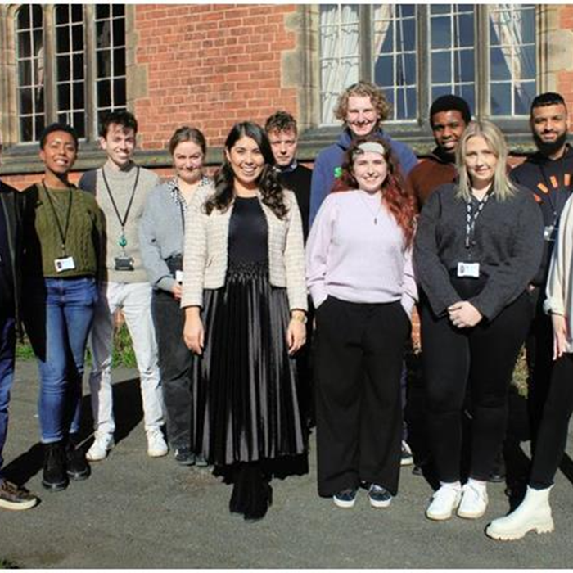
Our offer to you
  Trusted early – work on projects that matter
  Real pace – be part of a council that delivers
  Support to grow – with leaders who invest in your development
  Variety – broad experience to shape your career
  Be part of change – including local government reogranisation
  Flexible working – in a well-connected vibrant district

Slide 4
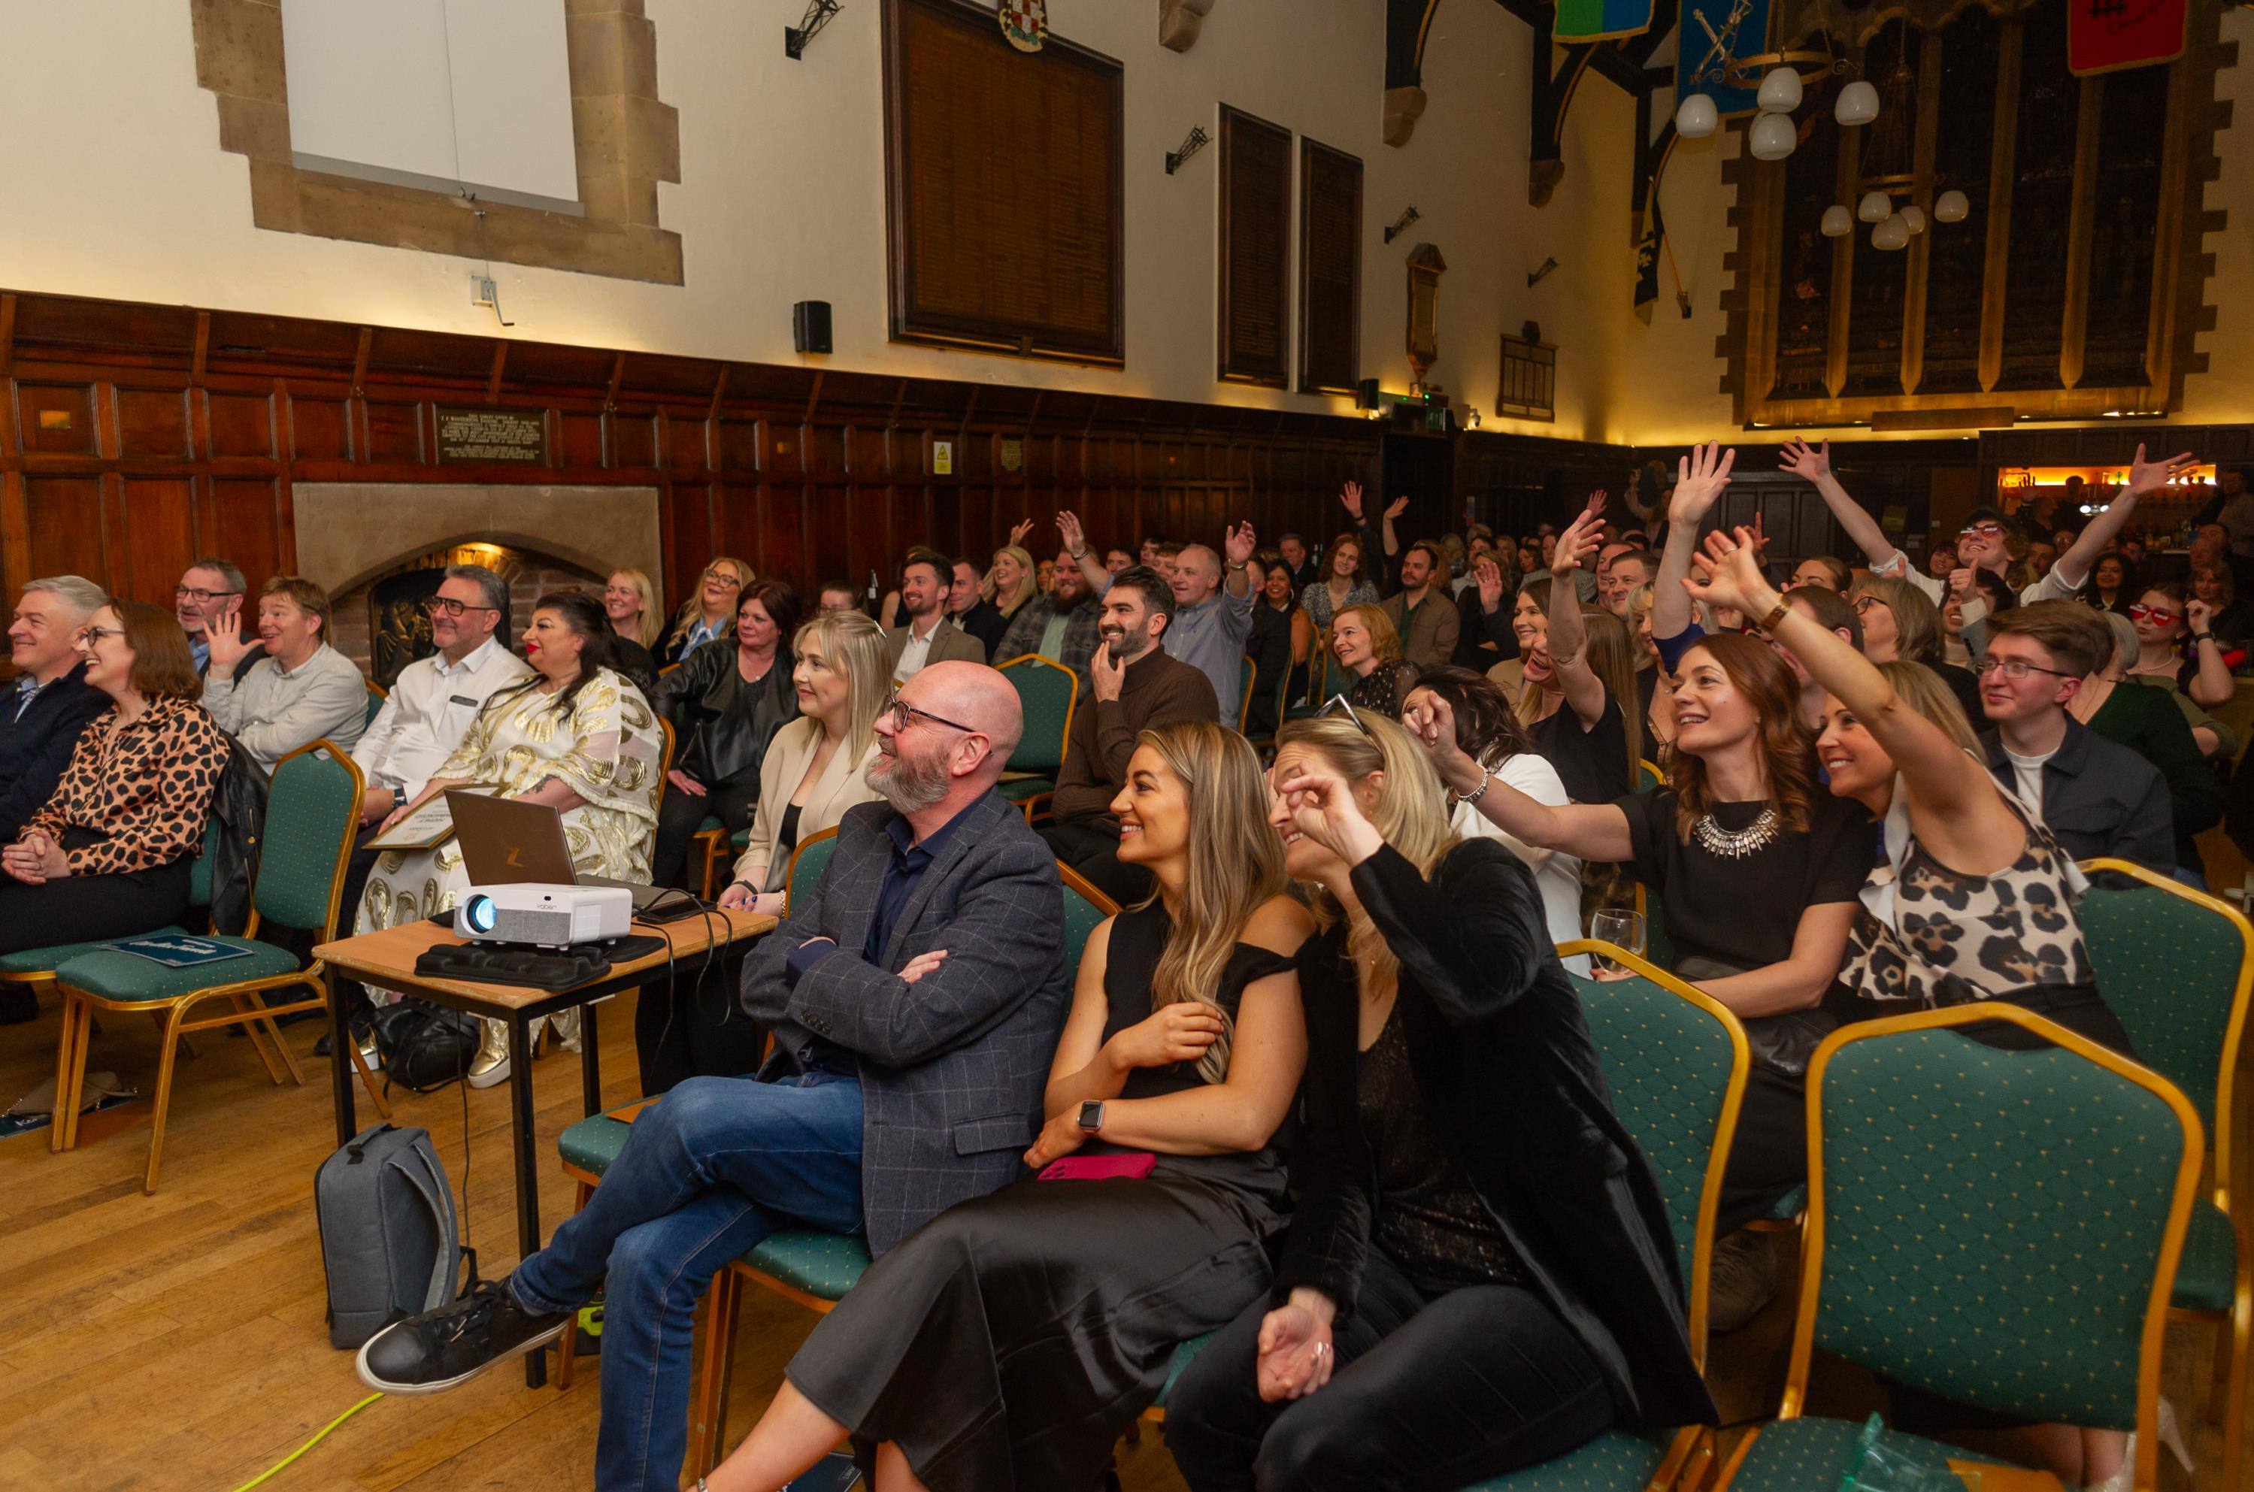
Fully funded private health insurance
Annual performance bonuses
Employee discounts platform
Discounted leisure centre memberships
Fully flexible and hybrid working
Modern, open plan offices
Sector leading staff benefits

Slide 5
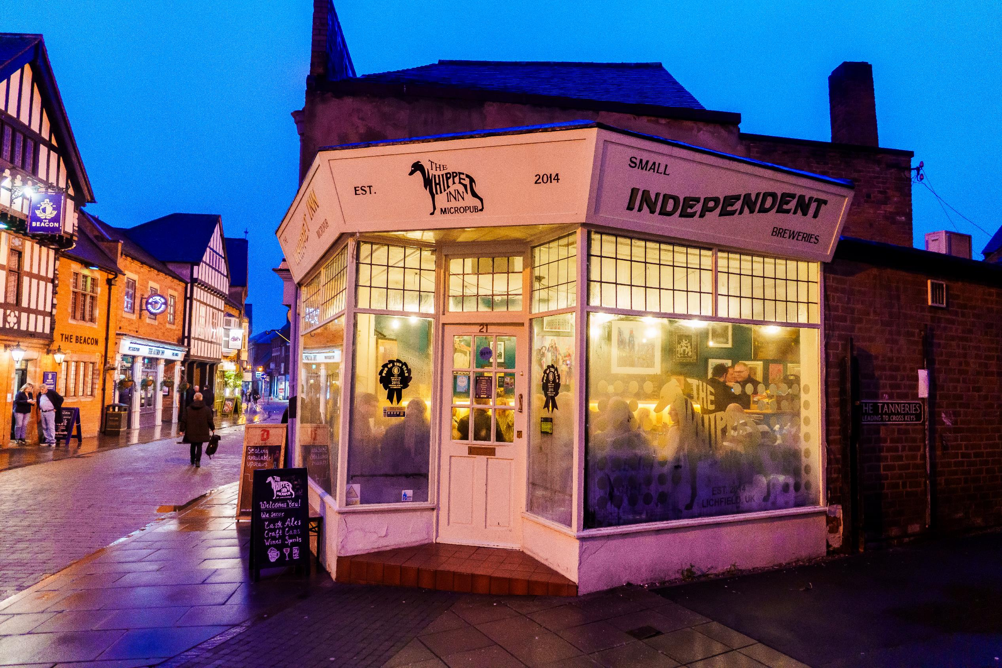
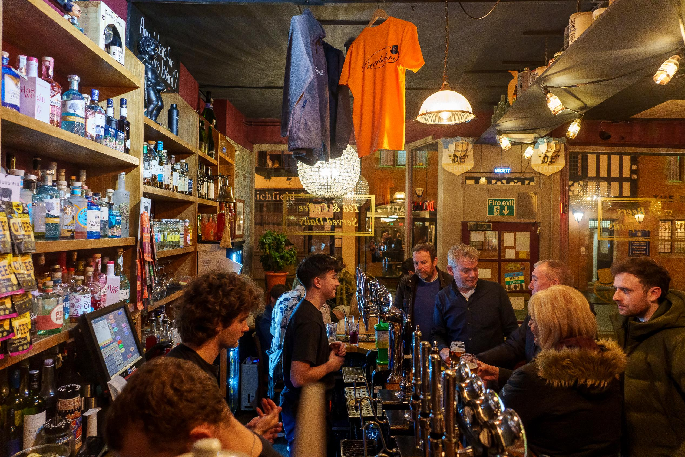
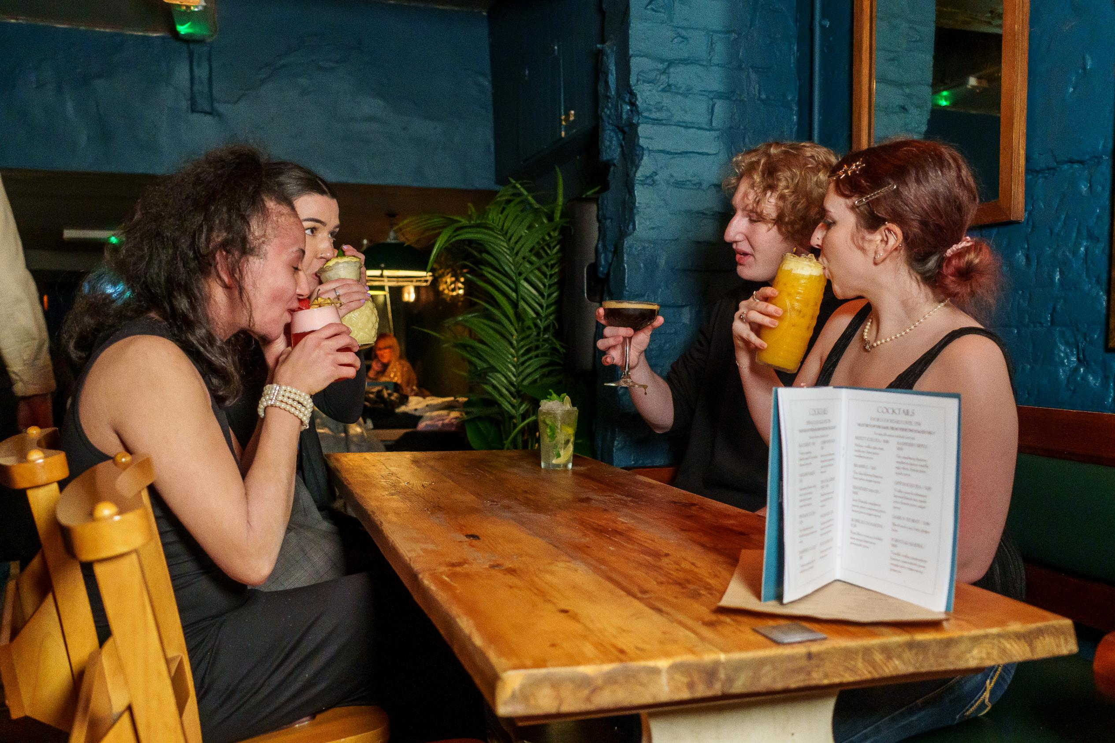
A great place to live and work
  Only 35 minutes from Birmingham – with great train and road connectivity
  Vibrant night-time economy – known for its bars, restaurants, and cultural offer
  Steeped in history and heritage – famous for its three steepled cathedral
  Award winning parks – with over 300 acres of green open space

Slide 6
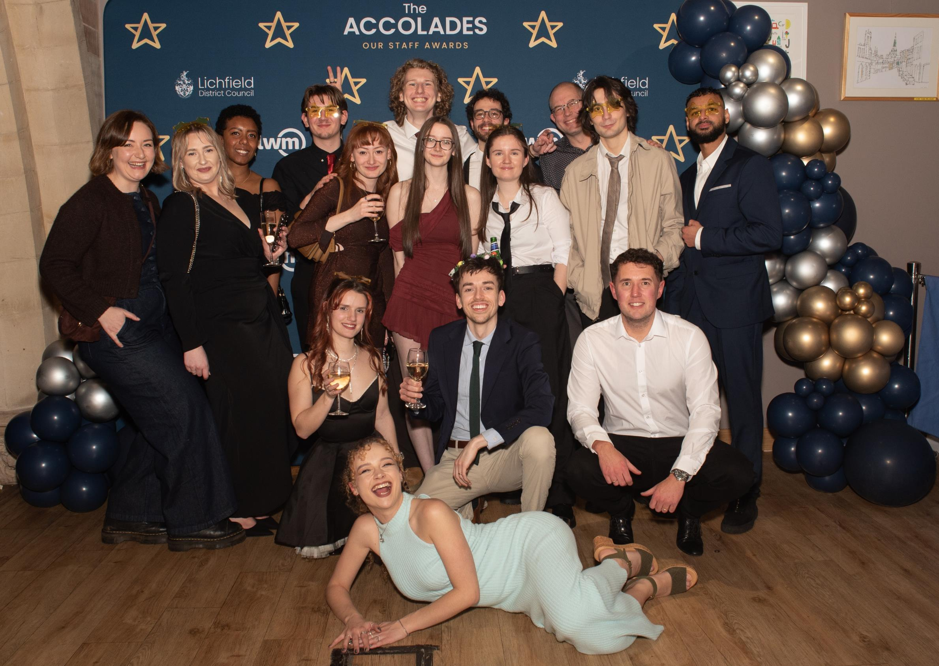
A council that invests in early careers
Supported 30+ young people via apprenticeships and graduate programmes
Commitment to giving you the best possible experience
You’ll work with senior leaders and councillors on a regular basis
Working on high-priority projects that have impact

Slide 7
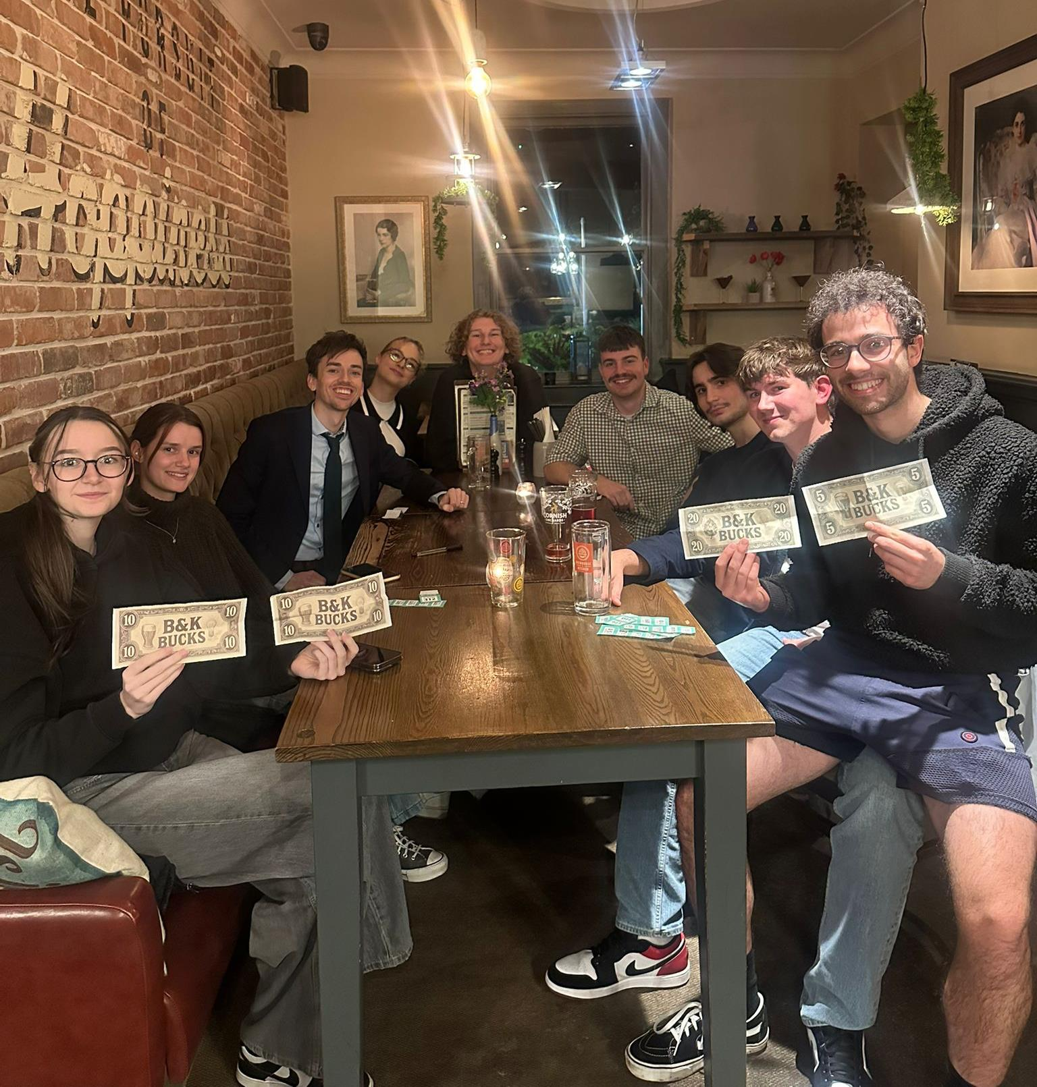
A vibrant Young Professionals Network
Set up by young professionals to create connection, confidence and further development opportunities
They meet regularly both socially and professionally
An open and inclusive network

Slide 8

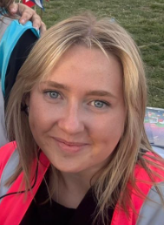
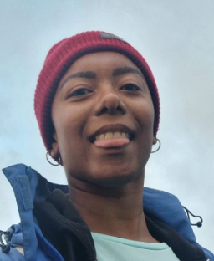
Don’t just take our word for it…
“It’s a really supportive place to start your career. After leaving uni I felt out of my depth, but everyone here is approachable and happy to help, which makes a bid difference. You can be yourself, learn on the job and get stuck into real work early on – plus it’s a genuinely fun place to work!"
Aimee
“Having worked for larger organisations in the past, coming to LDC has meant I no longer feel like a nameless cog in a machine.”
Xavier

Slide 9

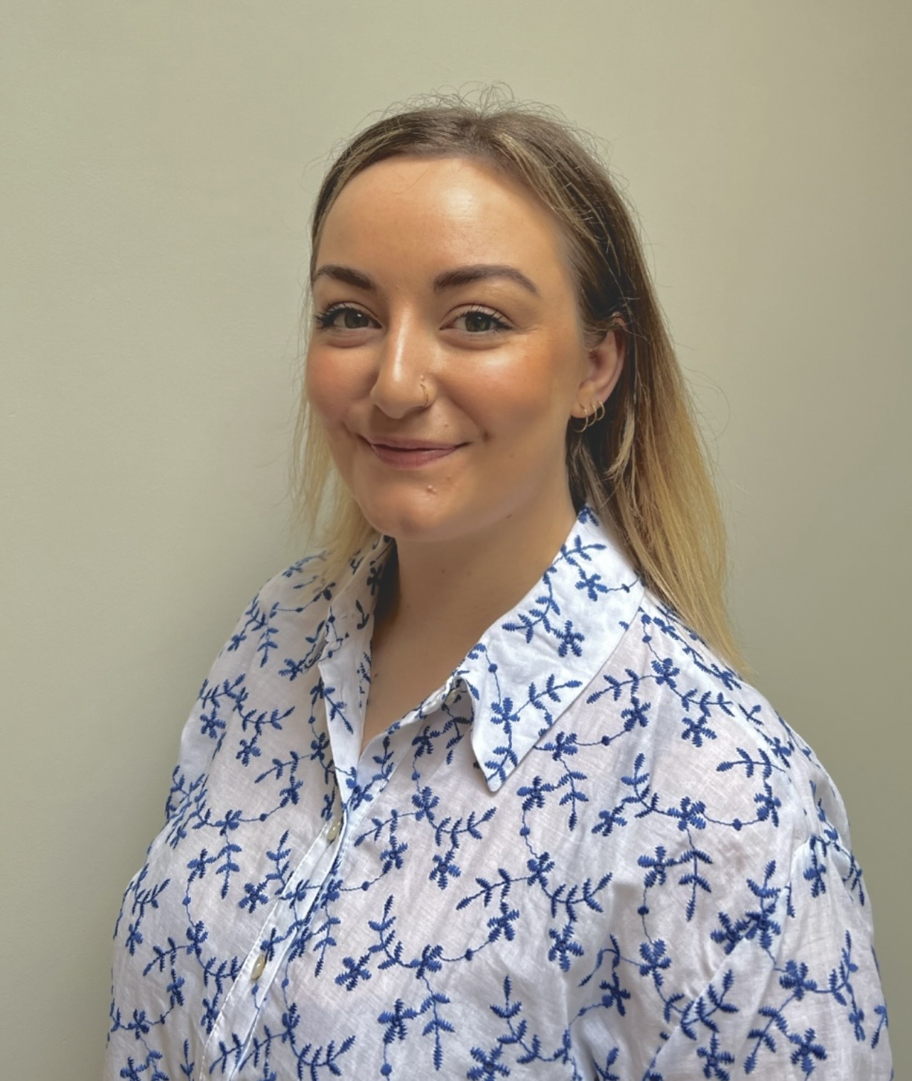
“As a young person working for LDC, the support from everyone at all levels has been incredible! People want to watch you win and help you get there. Working at LDC has been the best career move I’ve ever made.”
Georgia
“I've had so many fantastic experiences with LDC. They've given me the opportunity to try out my own ideas in the real world, support my career growth and work right at the heart of what a modern council should be."
Will
Don’t just take our word for it…

Slide 10
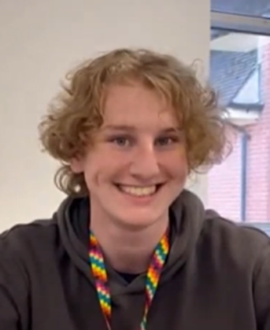

Don’t just take our word for it…
“I love the people here, everyone is genuinely really lovely. The work is fun, its engaging, I get to do stuff I actually enjoy and care about.“
Joe
“LDC has offered me so many different opportunities I hadn’t anticipated, and that scared me, but also nurtured my professional and personal confidence.”
Fiona

Slide 11
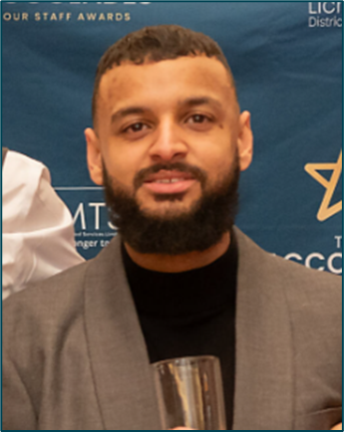
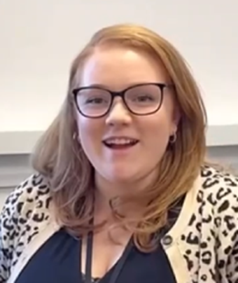
“I love the people here, I love who I work with. It’s just a really, really nice place to work!“
- Alex
“I’m now on my second apprenticeship with LDC… I enjoyed the first so much, I came back for more!”
Nathan
Don’t just take our word for it…

Slide 12

Share your contact details
To receive more information about working at Lichfield District Council register your email address via the form

